Slide 1

Web Overview
&
Introduction to HTML
Presented by: Hau Nguyen
Notes:
Get connected
Self introduction
Engagement questions
Will have gifts if you can answer questions
——
How many of you didn’t know HTML/CSS before?
How many of you already know HTML/CSS?
How many of you never heard about HTML/CSS?

Slide 2

About me
Open, Friendly
University of Science
Fullstack at KMS
Leader at Gee Pacific
SSE at fram^
Tutor/Instructor at Nordic Coder

Slide 3
And YOU
:)

Slide 4
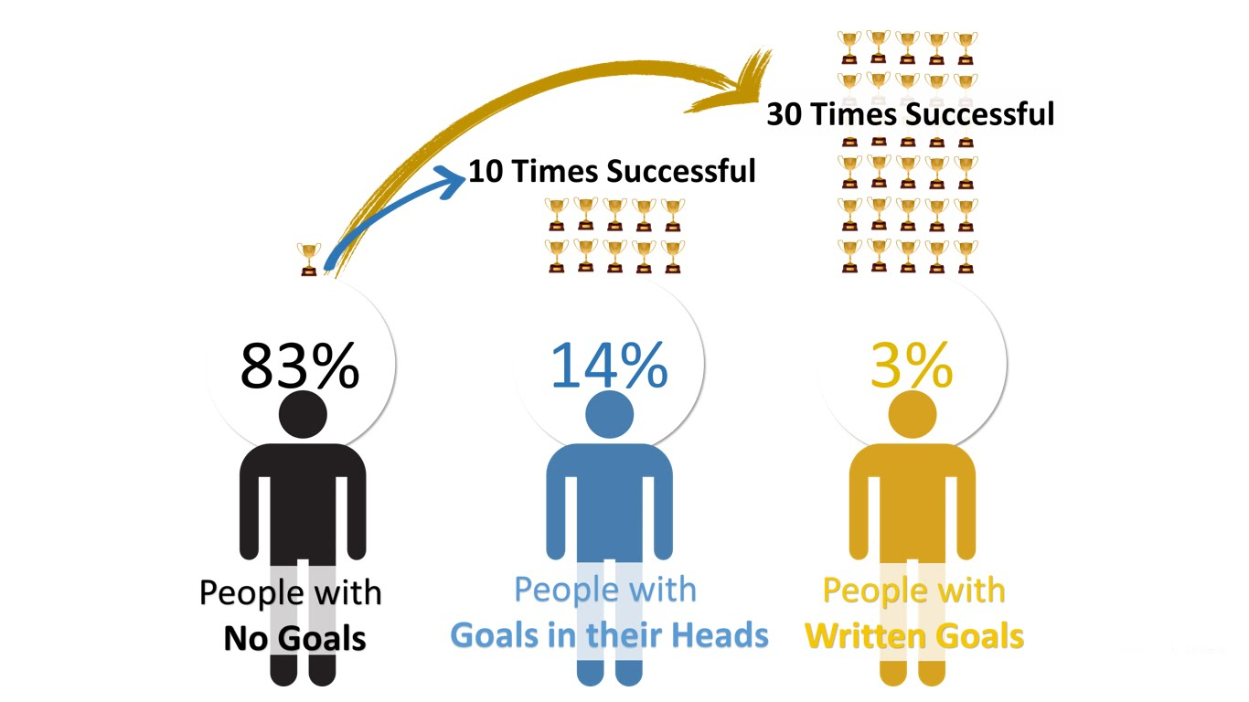
Let’s set your goal!!!
https://financesonline.com/tips-writing-goals-increase-productivity-work/

Slide 5

Notes:
Lets share your goals with your friends in a very short sentence & easy to remember.
Format:
Your name
Your current work
Your goal in short sentence

Slide 6

Notes:
TEAM UP
Divide class into small groups of 4 people, then vote a leader for each.
A group need to work together to help all members finish the lab on time.

Slide 7
Agenda
Web Overview
How we learn
Web Overview
Introduction to HTML
Lab: Simple profile page
Q & A

Slide 8

How we learn
10 working sessions
Labs on class
Weekly assignment
Final project presentation
Mid-term checkpoint

Slide 9
How to win this course
Come earlier 5-10m
Ask questions
Do homework
Read more tutorials
Attend 12/12 sessions <3

Slide 10
Web Overview

Slide 11
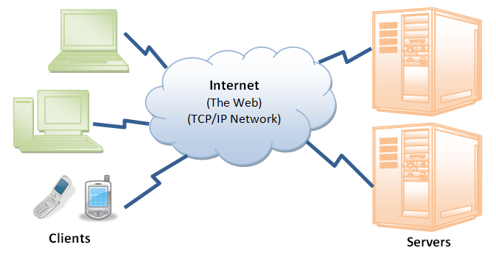
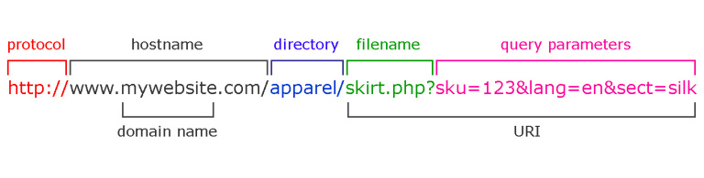
Web Overview
Front-end (HTML, CSS, JS)
Back-end (Database, API,…)

Slide 12
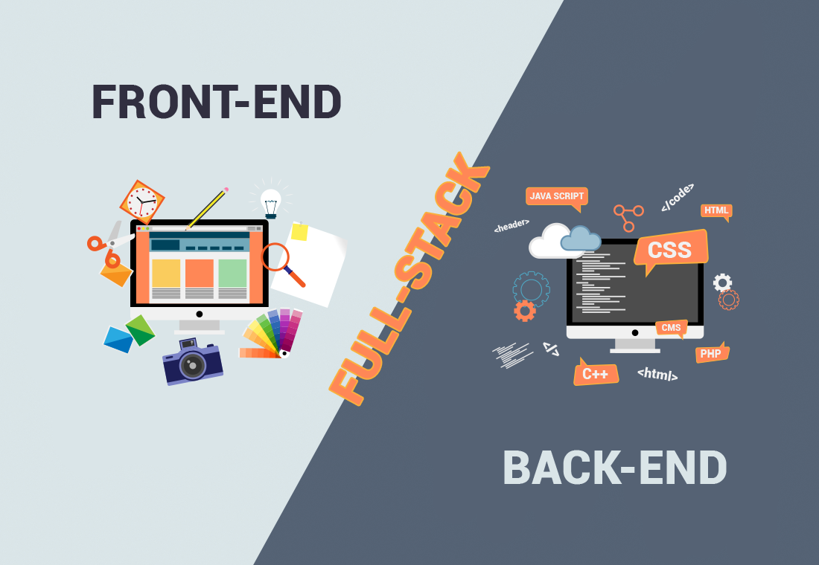
Overview

Slide 13
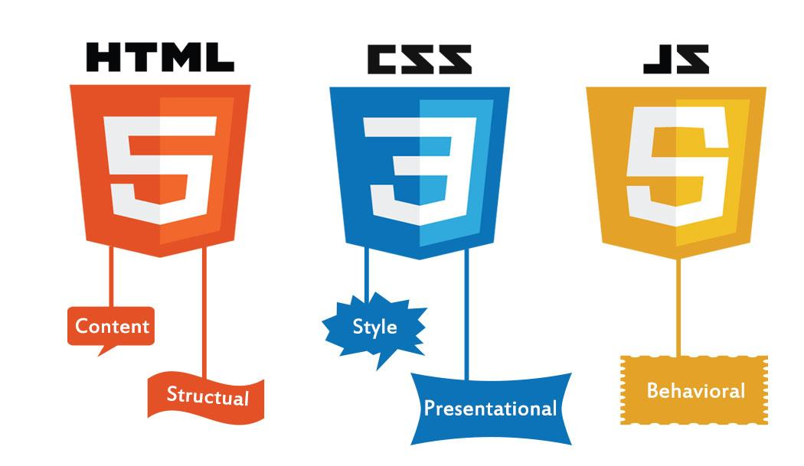
Technologies that drive the web

Slide 14
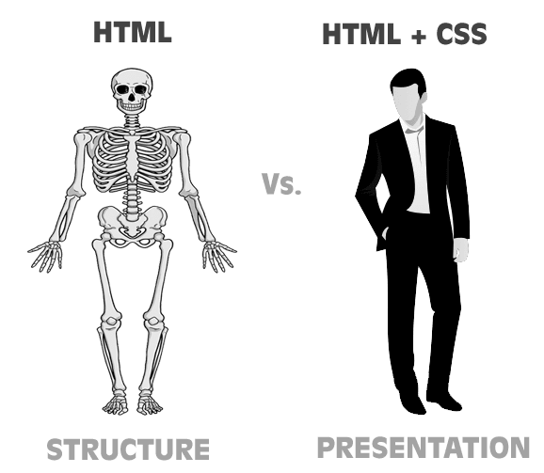
What is HTML/CSS actually!??

Slide 15
What is HTML?

Slide 16

What is HTML?
HyperText | Markup | Language

Slide 17
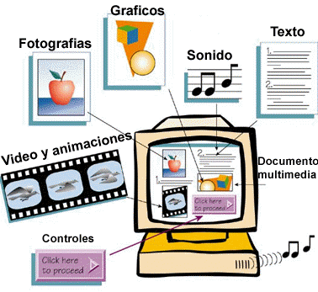
HyperText Markup Language

Slide 18
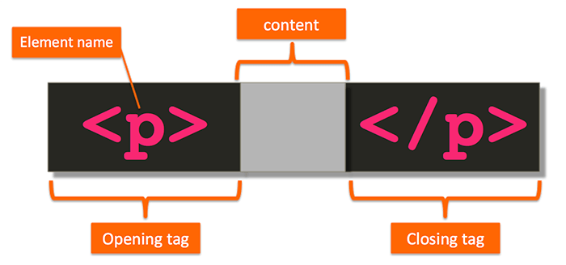
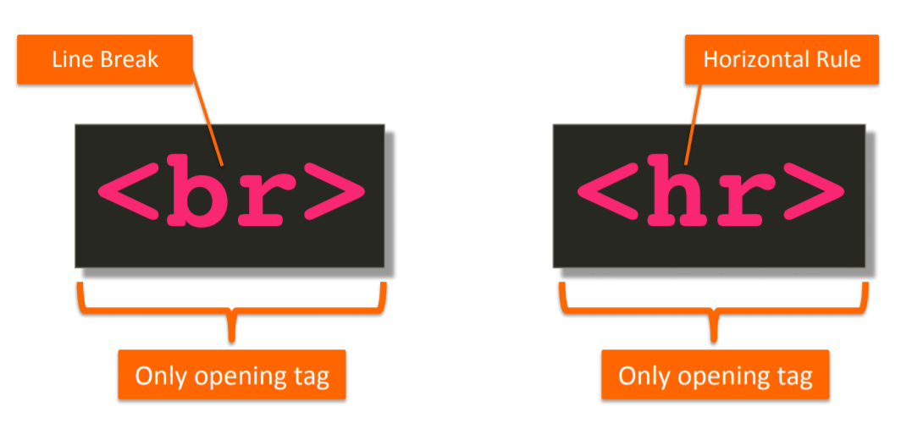
HyperText Markup Language
Markup with tags

Slide 19
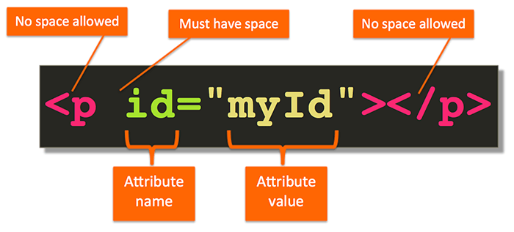

HyperText Markup Language

Slide 20
HTML
Main Concepts

Slide 21
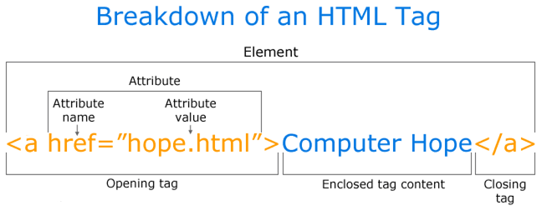
Elements, Tags, Attributes

Slide 22
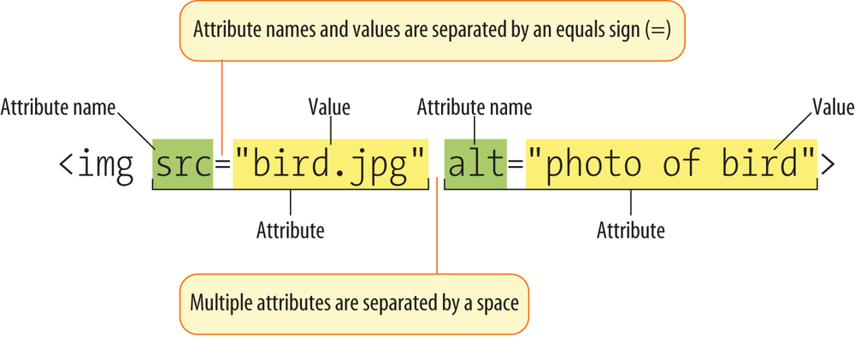
Elements, Tags, Attributes

Slide 23
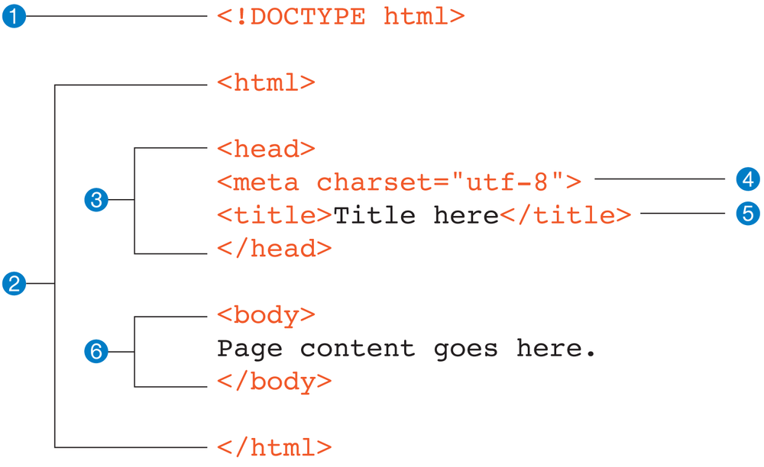
HTML Page Structure

Slide 24
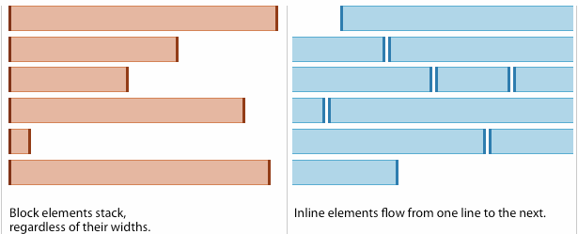
Block vs Inline Elements

Slide 25
HTML
Common Used Tags

Slide 26
Get what you need
Need | Use tag
Heading | h1 -> h6
Paragraph | p
A block of content (division) | div vs span
Image | img
An un-ordered list of items | ul, li
An ordered list of items | ol, li
Pre-formatted text | pre
Anchor | a

Slide 27
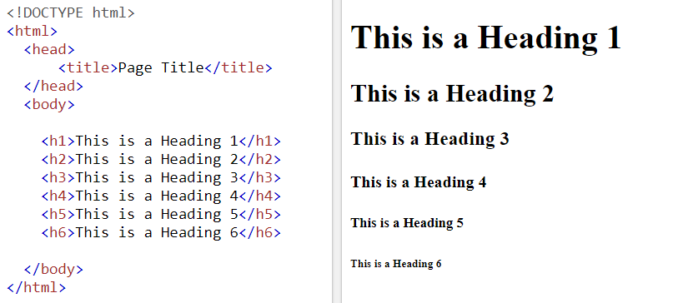
Headings (block)

Slide 28
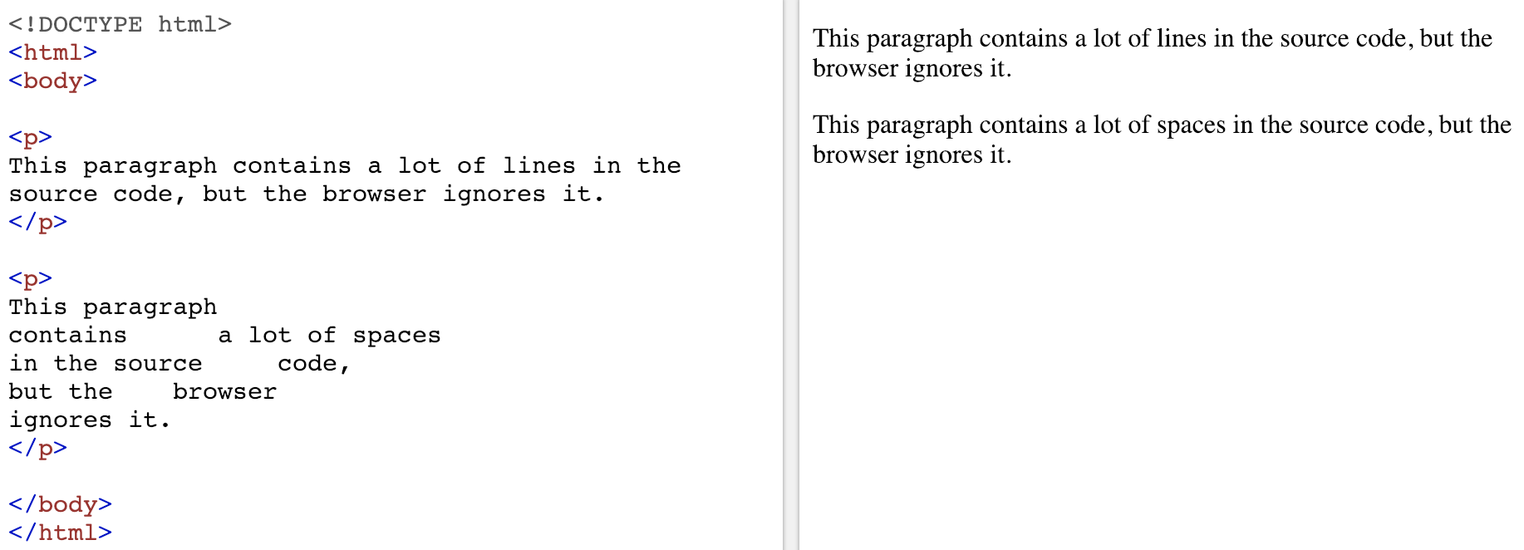
Paragraph (block)

Slide 29
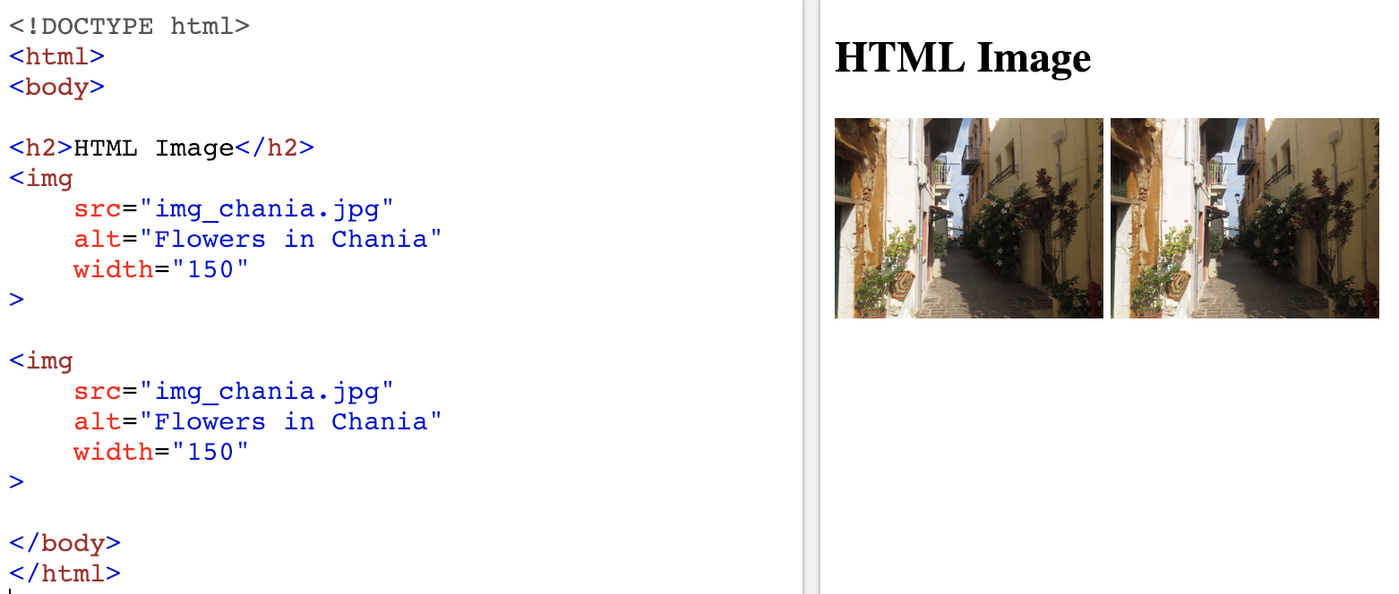
Image (inline)

Slide 30
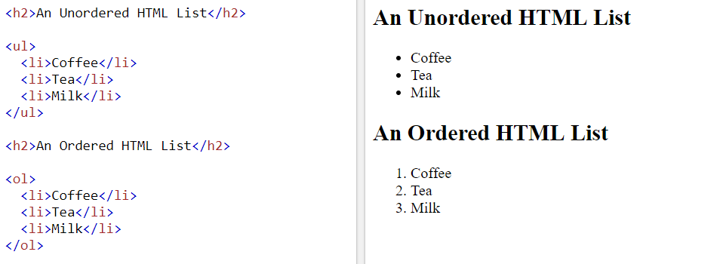
List (block)

Slide 31
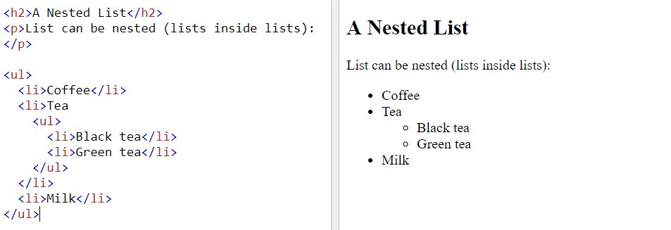
List can be nested (block)

Slide 32
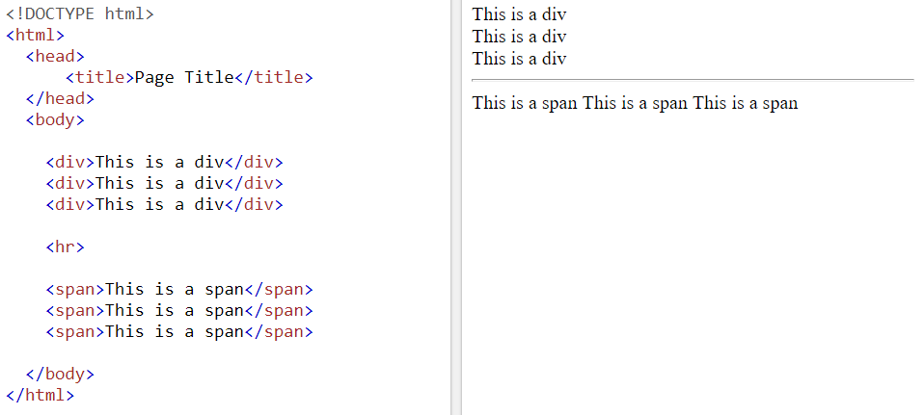
Division (block) vs span (inline)

Slide 33
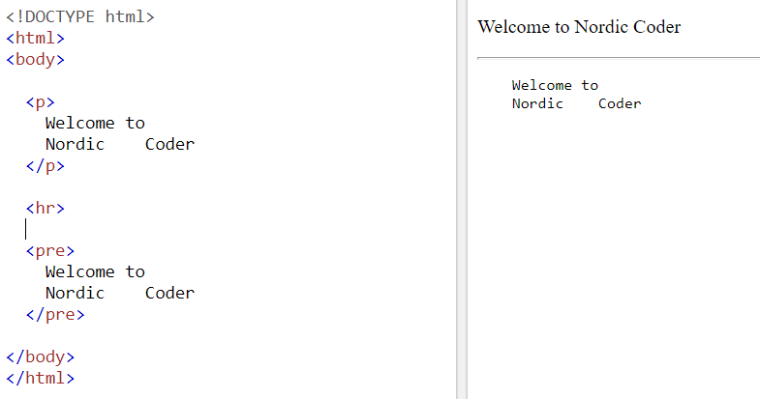
Pre-formatted text (block)

Slide 34
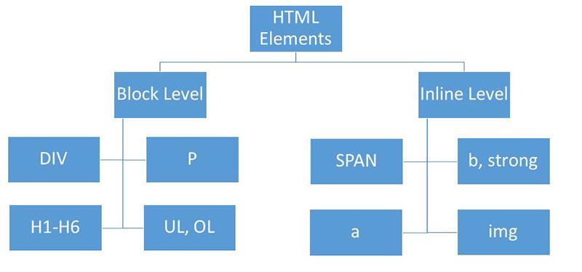
Block vs Inline Elements

Slide 35
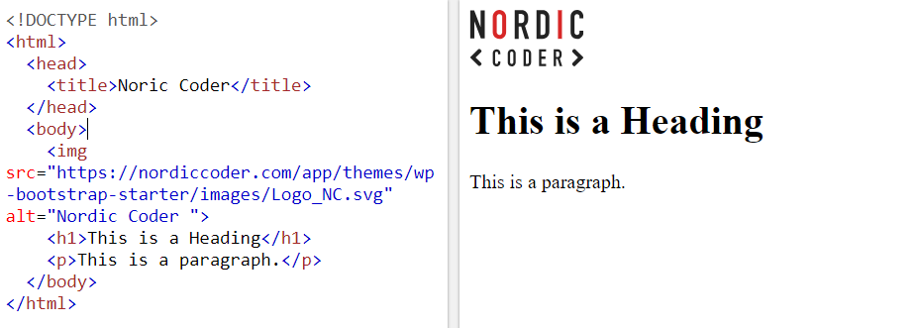
Sample HTML
HTML Code
Result

Slide 36


Slide 37
Summary
Alright, what did we learn today?
Web Overview
Setting goals
Labs & Assignments
Introduction to HTML

Slide 38


Slide 39

Thank You And see you ;)

